Slide 1

Slides for Chapter 2:
Architectural Models
From Coulouris, Dollimore, Kindberg and Blair
Distributed Systems:
Concepts and Design
Edition 5, © Addison-Wesley 2012

Slide 2
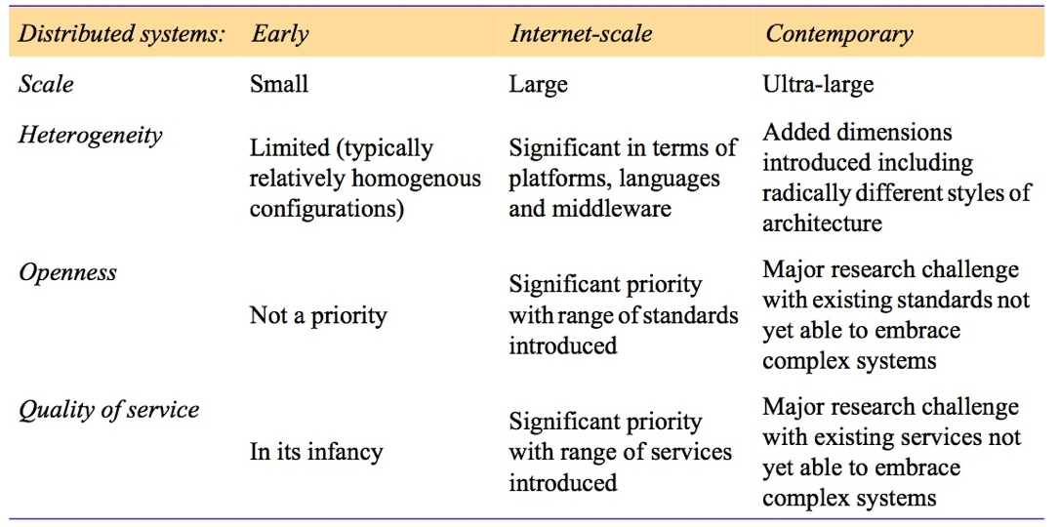
Figure 2.1
Generations of distributed systems

Slide 3
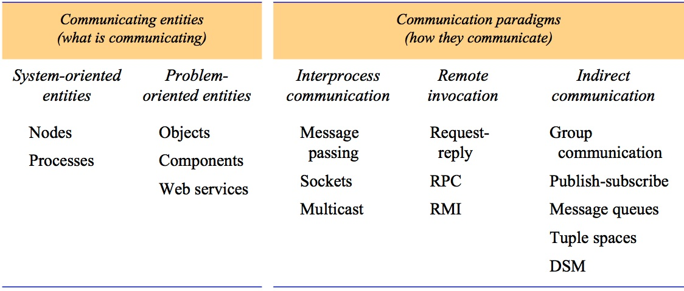
Figure 2.2
Communicating entities and communication paradigms

Slide 4
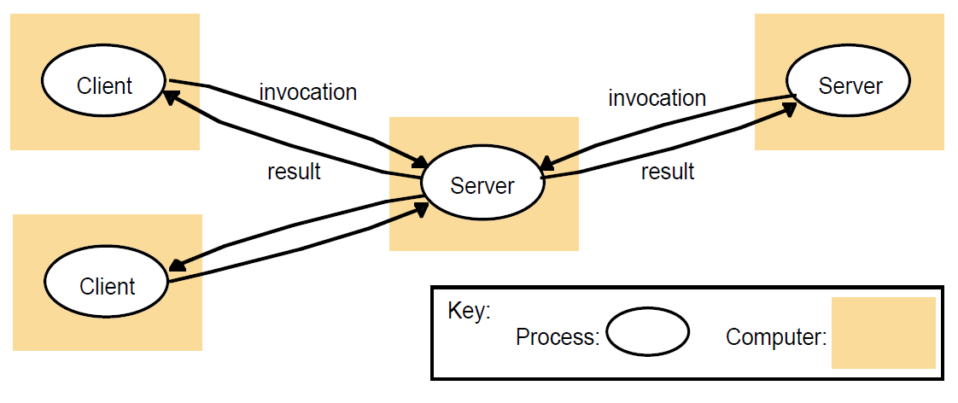
Figure 2.3
Clients invoke individual servers

Slide 5
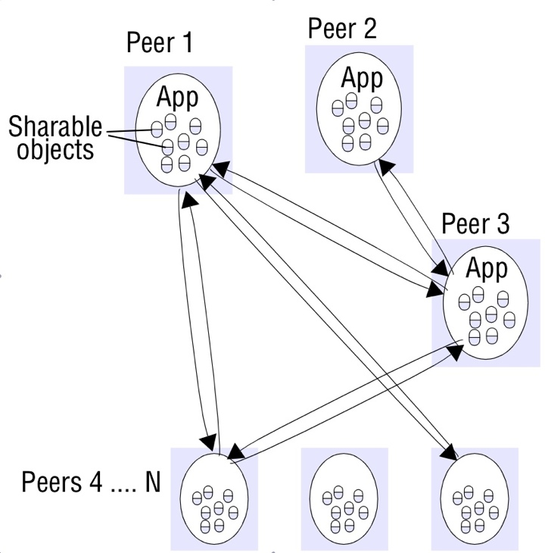
Figure 2.4a
Peer-to-peer architecture

Slide 6
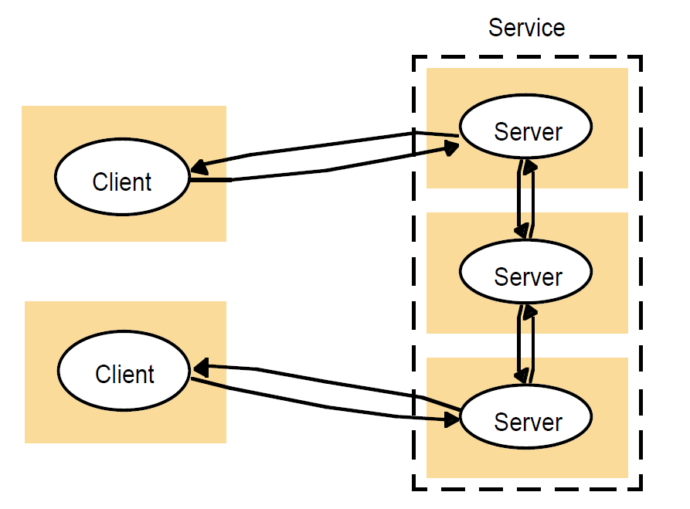
Figure 2.4b
A service provided by multiple servers

Slide 7
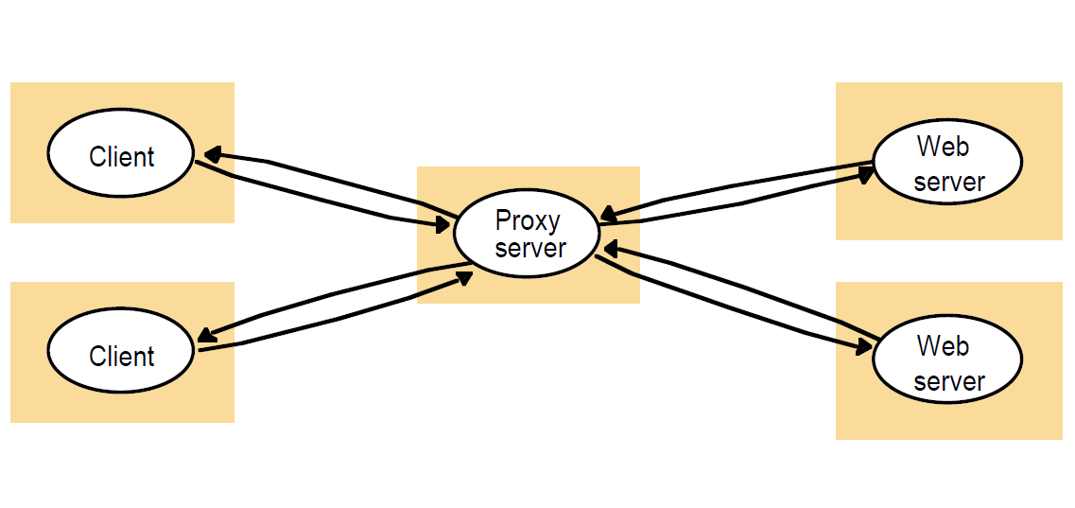
Figure 2.5
Web proxy server

Slide 8
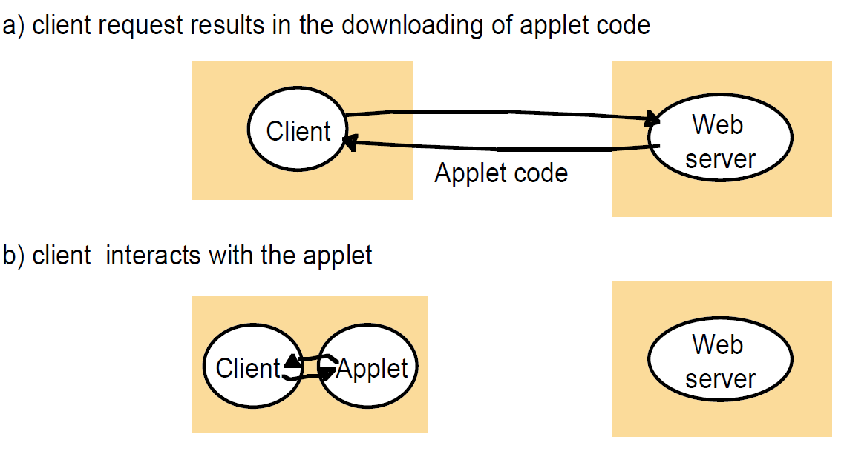
Figure 2.6
Web applets

Slide 9
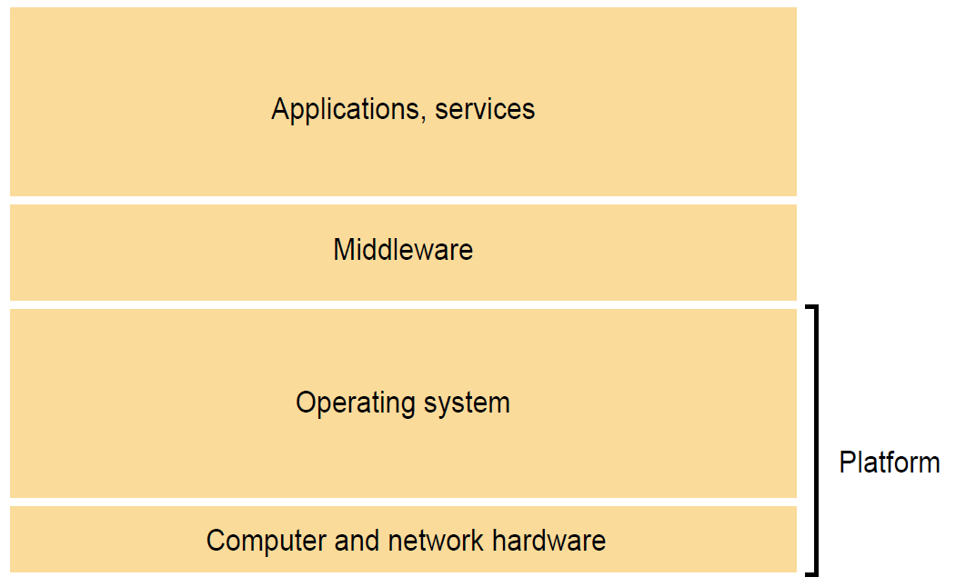
Figure 2.7
Software and hardware service layers in distributed systems

Slide 10
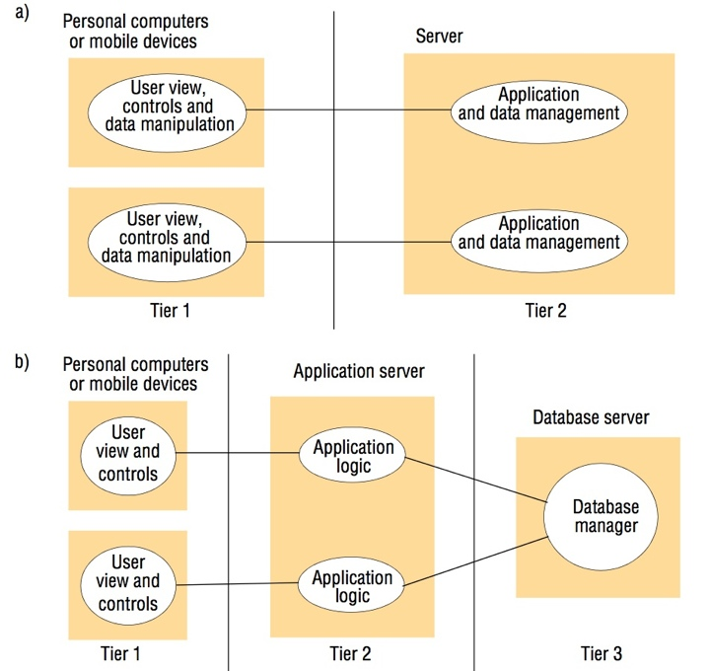
Figure 2.8
Two-tier and three-tier architectures

Slide 11
Figure 2.10
Thin clients and compute servers
Compute server
Network computer or PC
Thin
network
Application
Client
Process
Instructor’s Guide for Coulouris, Dollimore, Kindberg and Blair, Distributed Systems: Concepts and Design Edn. 5
© Pearson Education 2012

Slide 12
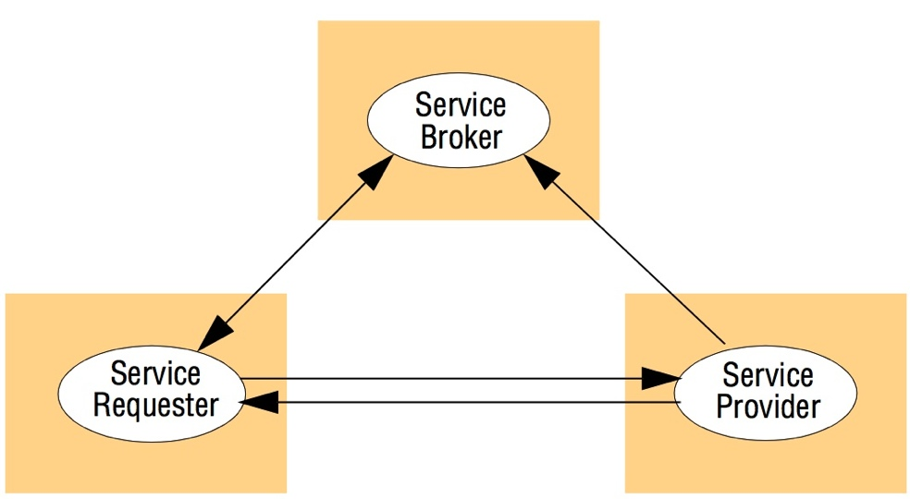
Figure 2.11
The web service architectural pattern

Slide 13
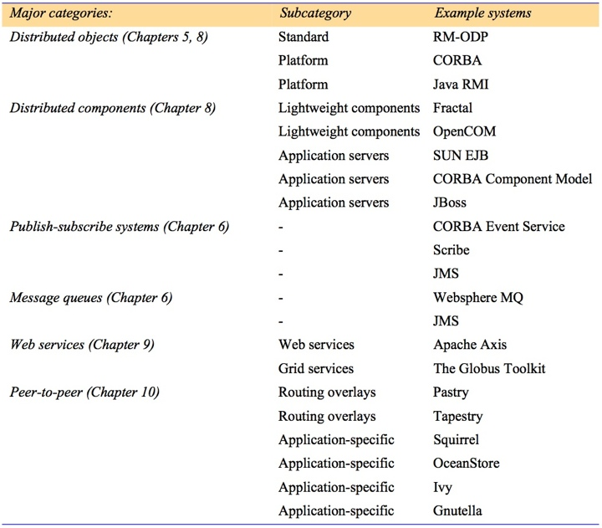
Figure 2.12
Categories of middleware

Slide 14
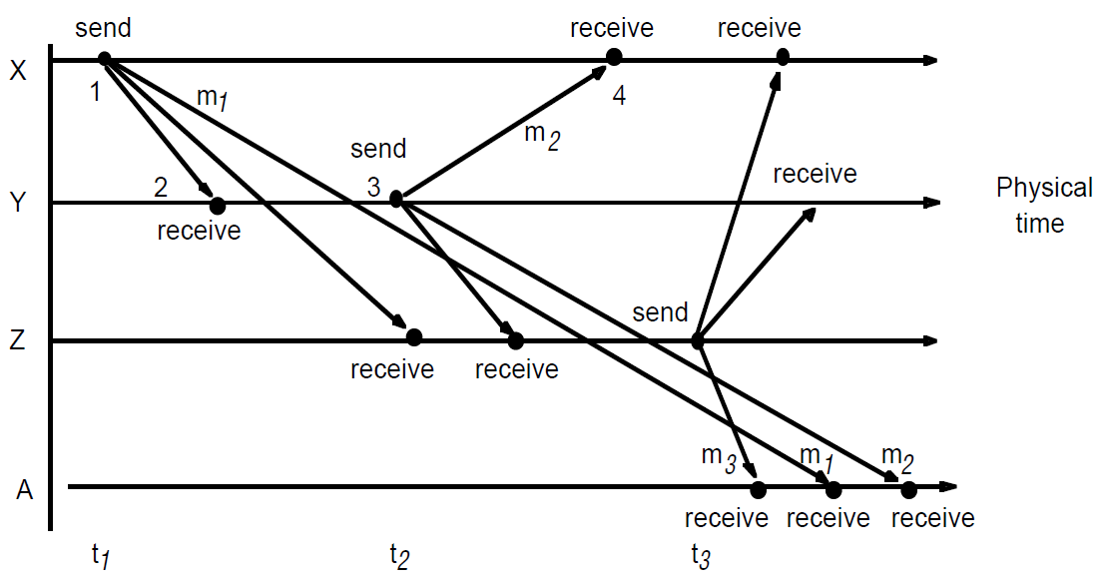
Figure 2.13
Real-time ordering of events

Slide 15
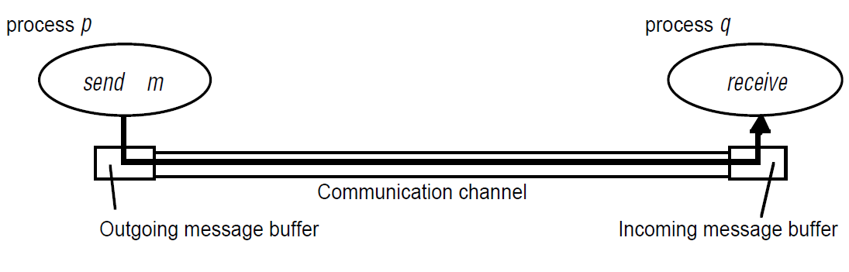
Figure 2.14
Processes and channels

Slide 16
Figure 2.15
Omission and arbitrary failures
Class of failure
Affects
Description
Fail-stop
Process
Process halts and remains halted. Other processes may
detect this state.
Crash
Process
Process halts and remains halted. Other processes may
not be able to detect this state.
Omission
Channel
A message inserted in an outgoing message buffer never
arrives at the other end’s incoming message buffer.
Send-omission
Process
A process completes a
send,
but the message is not put
in its outgoing message buffer.
Receive-omission
Process
A message is put in a process’s incoming message
buffer, but that process does not receive it.
Arbitrary
Process or
Process/channel exhibits arbitrary behaviour: it may
(Byzantine)
channel
send/transmit arbitrary messages at arbitrary times,
commit omissions; a process may stop or take an
incorrect step.

Slide 17
Figure 2.11
Timing failures
Class of Failure
Affects
Description
Clock
Process
Process’s local clock exceeds the bounds on its
rate of drift from real time.
Performance
Process
Process exceeds the bounds on the interval
between two steps.
Performance
Channel
A message’s transmission takes longer than the
stated bound.

Slide 18
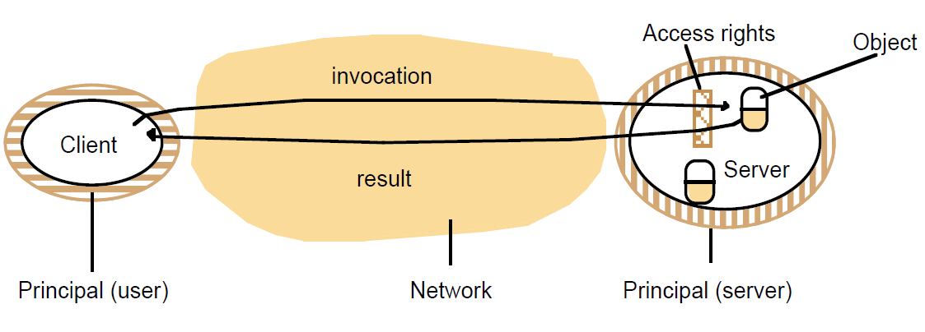
Figure 2.17
Objects and principals

Slide 19
Figure 2.18
The enemy
Copy of
m
The enemy
m’
Process
p
m
Process
q
Communication channel

Slide 20
Figure 2.19
Secure channels
Principal
A
Principal
B
Process
p
Secure channel
Process
q

